Slide 1
2025 Edwardsville High School Cross-Country
Parent and Athlete Informational Meeting
Thursday, May 8, 2025

Slide 2
Welcome to the 2025 EHS XC Family!

Slide 3
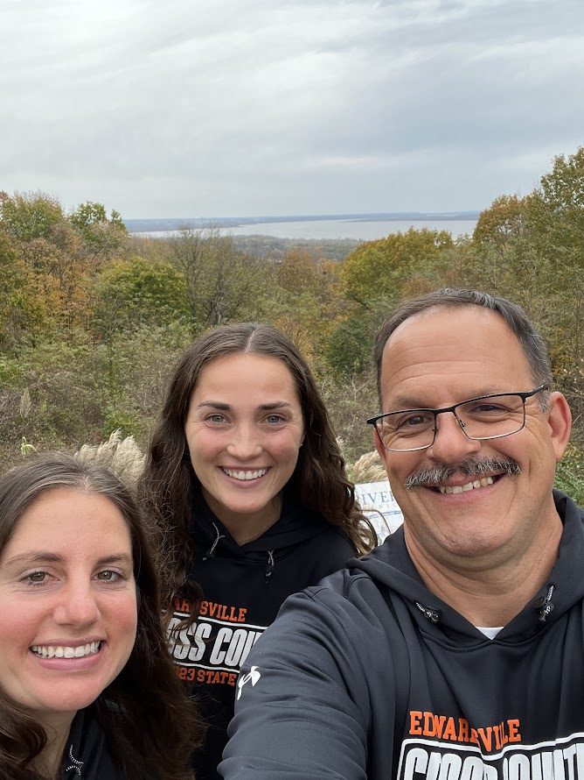
EHS Coaching Staff:
George Patrylak:
Head Cross-Country Coach
Assistant Boys Track and Field Coach (Distance)
618-567-5792 gpatrylak@ecusd7.org
Alexis Keller:
Assistant EHS Cross-Country Coach
618-616-5314 akeller@ecusd7.org
Keri Burmester
Assistant EHS Cross-Country Coach
Assistant EHS Girls Track Coach
618-615-3031 kburmester@ecusd7.org

Slide 4
Contact Sharing/Team Snap
We will once again be using Team Snap to share information. You must download the Team Snap App on your phone.
Please, create your own contact on your phone. Please include:
Your First and Last Name
Your cell phone number
Your email address
For your company, please enter EHS XC
Please share this contact with Coach P. by sending a text/share contact to 618-567-5792. Thank you!

Slide 5
Mission Statement
To introduce high school student athletes to the sport of cross-country (distance) running
while remaining one of the most competitive cross-country programs in the State!
Creating a nurturing, supportive and family atmosphere | With an emphasis on teaching skills to help athletes become better runners, students, and individuals | While learning the principles of hard work, determination, sportsmanship, teamwork, goal setting, respect, and friendship

Slide 6
High School XC Meets: Divisions
Varsity
Fresh/Soph Boys
Junior Varsity Girls
Open: Everyone who has not already competed
Post Season Meets (Regionals, Sectionals, and State Series at the IHSA Levels):
During the post season, only varsity teams compete. IHSA starts with Regionals, and only the top five teams and top five individuals qualify to Sectionals. At Sectionals, only the top seven teams and top ten individuals advance to State.

Slide 7
2024 Accomplishments
Girls Team
Conference Champions
Regional 1st Place
Sectionals 2nd Place
8th Place State Finish (Highest State Finish in School History)
Hall of Fame Additions: 3) Madison Popelar: 17:36.1, 4) Morgan Popelar: 17:36.8, 7) Willow Jackson: 17:40.2 and 20) Ella Thompson: 18:22.5.
Boys Team
School history, with all 7 varsity runners under 16:00 in one race.
Conference Champions
Regional Runner-Up
Sectionals 3rd Place
13th Place State Finish
Hall of Fame Additions: 6) Gavin Rodgers: 14:41.3, 11) Hugh Davis: 15:00.0 and 19) Colin Thomas: 15:11.9.

Slide 8
Goals for 2025

Slide 9
2025 Goals
Each athlete will come up with personal goals over summer and will record their goals on a goal sheet.
The EHS XC Coaching Staff will meet with each athlete to discuss goals and will meet with the athletes throughout the season to discuss individual progress on goals.
Team Captains will develop team goals with team members and present these goals to the coaching staff.
You are responsible to create, work towards and meet your individual and team goals!

Slide 10
Mileage Club
 | Freshmen | Sophomores | Juniors | Seniors
Boys | 25-35 | 35-45 | 45-55 | 55+
Requirement | 250 Miles | 350 Miles | 450 Miles | 500 Miles
 | Freshmen | Sophomores | Juniors | Seniors
Girls | 20-30 | 25-35 | 30-40 | 35-45
Requirement | 200 Miles | 250 Miles | 300 Miles | 350 Miles
Any athlete who meets or exceeds his or her required number of miles will be part of the 2025 Mileage Club and will earn a Mile Club T-Shirt. In order to meet the requirements of the Mileage Club, all miles must be logged.
All first year runners will have to meet the Freshman requirements to
become members of the Mileage Club!

Slide 11
“Earning Your Tiger Stripes”
We realize not all athletes will be able to earn Mileage Club Shirts, so we are coming up with a new way to recognize your dedication to our program.
We have 20 contact days during the summer. Anyone who is present for 15 or more of those contact days will receive an “I Earned My Tiger Stripes This Summer” shirt.
We hope that at least 75% of our athletes “Earn their Stripes” and at least 50% of our athletes earn “Mileage Club” shirts.

Slide 12
Logging Mileage
Athletes will be expected to log in all of their mileage for the entire season, including summer running.
Athletes are expected to provide as much accurate information as possible when logging mileage, including the distance, pace and location of the run, how he or she felt and workout splits/pacing as appropriate.
All mileage should be logged on Strava. Our team ID is: EdwardsvilleHighSchoolCrossCountryTrack
We will accept a detailed written log as well.

Slide 13
Nutrition
We will try to have a Nutritionist speak with the team later in the year. All parents and athletes will be invited to this meeting. Until then………
Whether you are new to the sport or you are a seasoned veteran, during cross country you will be working harder than you ever had before.

Slide 14
Nutrition Continued
Drink plenty of water (at least ½ of your body weight in ounces a day).
Eat foods that are high in iron. Iron deficiencies have been one of our biggest concerns during the past few seasons. Meat and beans are a great source of iron.
Make healthy food choices: fruits, vegetables, and protein. Avoid soda, candy, chips, fried food, and most fast food.

Slide 15
Equipment
A good pair of training shoes. Cost between $80-$200.
Coach P’s Advice: if you have had success in a shoe, stick with it.
Cyclery/First to the Finish/Runwell – 20% off for EHS athletes
Most high school athletes get 300-500 miles on 1 pair of shoes if used for running only.
Cross-Country Spikes. Cost between $40-$180.
Right now is best time to buy past models.
Team Shorts. Cost approximately $30-$50.
We will have shorts to hand out if you do not want to buy your own.
Team shirts will be provided by the EXCTF Booster Club.

Slide 16
Basic Summer Schedule
This year we will split the week so we have one practice in the morning and one in the evening on most days.
Conditioning is highly recommended if you want to reach your full potential.
If you are unable to attend conditioning due to work or summer school, please find someone in a similar situation and run with him or her at a scheduled time.
Tentative Schedule:
Monday: Water Shed at 7:00 a.m. or 6:00 p.m.
Tuesday: RunWell in Edwardsville (Community Runs) at 6:00 p.m. Family members can join us on these days.
Wednesday: Pool Workouts @ Chuck Fruit Center at 9:00 a.m. Yoga TBD at 4:30 pm. HOST RUNS (TBD) at 6:00 p.m.
Thursday: Cross Country Course at 7:00 a.m. or 6:00 p.m.
Friday: Senior lead opportunities. Coaches will not be present.
Our first summer practice will be on Monday, June 9, 2025.
Our new community runs will be every Tuesday and will be at RunWell. Runners of all ages and abilities are welcome. We will be inviting local running clubs, parents, siblings, middle schools and high schools to participate. All participants will require a waiver to be completed.

Slide 17
What Are Host Runs?
Each Wednesday night (beginning on Wednesday, June 11) we are looking for families to host a run.
This is the only practice day where boys and girls will be separate and coaches will not be present.
This is a great team building event that really benefits freshman and first year runners.
Parents can sign up to host a run on Facebook starting tonight (first come, first serve basis).

Slide 18
Requirements
By agreeing to participate in extracurricular activities at EHS, all athletes agree to follow District 7’s Code of Conduct agreement. The Code of Conduct is enforced 24 hours a day, 7 days a week! The Code of Conduct will be found in student agendas. Be sure to go over the Code of Conduct with your son/daughter.
All mandatory paperwork, including a physical, must be turned in. These forms will be going on-line in June on the district website at www.ecusd7.org. Parents and athletes, please be sure to sign the physical, along with the concussion and steroid consent forms as applicable.
All athletes will be required to view a concussion video before he or she is eligible to compete. We will fulfill this requirement as a team later this summer.

Slide 19
Rules
Respect : Cross-country develops more than individuals, it develops a family. Each person is an important part of our family. Treat everyone with respect.
No Profanity: Team exercises will be used to curve this habit. Excessive remarks can lead to the removal from the team.
Attendance: Attendance is mandatory. After three unexcused absences during the regular season, the athlete will be removed from the team. If an athlete has an unexcused absence the week of a meet, coaches have the right to withhold that athlete from competition that week.

Slide 20
Rules Continued:
Communication: If you feel a pain or have an injury, tell the coaching staff immediately. Your health and safety is a priority.
Injuries: If an athlete is too injured or sore to running during the week, he/she will not be allowed to compete in any meets that week unless the rest is part of the training plan created with our trainer.
Notes:
***stay until the end! Ride home with the team

Slide 21
Tentative Meet Schedule
Sat 7/26 Mud Mountain 5k SIUE Sat 8/30 Belleville West Quad meet Belleville West Wed 9/3 O’Fallon F/S Invite O’Fallon Sat 9/6 Granite City Invite Granite City Sat 9/13 Peoria Woodruff Invite Peoria, IL Sat 9/21 Edwardsville Invite SIUE Sat 9/27 Palatine Invitational Palatine, IL Sat 10/4 Peoria High Invite Peoria, IL Tue 10/7 Madison County Championships TBD Tue 10/14 SW Conference Championships SIUE Mon 10/20 Cross Country Finale O’Fallon Sat 10/25 IHSA Regional TBD Sat 11/1 IHSA Sectional TBD
Sat 11/8 IHSA State Peoria, IL

Slide 22
Social Media
Please request to join the Edwardsville XC group page.
A lot of the team communication takes place on this page!
Twitter (X) at @EdwardsvilleXC
www.mudmountain5k.org
Team Website:
https://coachpatrylak.wixsite.com/edwardsvillecc

Slide 23
Edwardsville Cross-Country Track and Field Booster Club (EXCTF)
The Booster Club supports the following:
Middle Schools:
Lincoln Middle School Boy’s and Girl’s XC Team
Liberty Middle School Boy’s and Girl’s XC Team
Lincoln Middle School Boy’s and Girl’s Track and Field Team
Liberty Middle School Boy’s and Girl’s Track and Field Team
High School:
EHS Boy’s and Girl’s XC Team
EHS Boy’s and Girl’s Track and Field Team
The programs average between 600-1000 athletes between the teams and levels each season! We are the second largest sport in terms of numbers in the district behind only the football program!

Slide 24
Booster Club Information
The EXCTF BC meets on the first Monday of each month (the next meeting is Monday, May 19) at 6:30 pm at Chava’s. Moving forward, we will meet in the Tiger Country building adjacent to the EHS Track Complex or another location.
As a parent, you are expected to volunteer for at least one event during the season to either help with course set-up/take down, concessions, finish line, or other event specific job. You are also expected to donate items for home meet concessions.
Parents are encouraged to join the booster club and to be actively involved in our program.
The EXCTF BC provides financial assistance to all teams. BC funds provide hotels for overnight stays, off-set the cost of charter buses as needed, uniforms, warm-ups, food for meets over 2 hours away, snacks and Gatorade, miscellaneous supplies and equipment, tents, etc.

Slide 25
Booster Club Information Cont.
Current BC Officers:
President: Chris Amick
Co-Vice President XC: Beth Wittek and the Popelars
Co-Vice President Boys TF: Sally Lakatos
Co-Vice President Girls TF: Marc Popelar
Secretary: Michelle Meckfessel
Treasurer: Keith Lueking
Co-Trivia Night Coordinator: Sally Lakatos
Mud Mountain Race Directors: George Patrylak
**New Elections will be in June of 2025 if you are interested in serving as an officer for the 2025/2026 school year.

Slide 26
Major Fund Raising Events:
Trivia Night:
In January, we will be hosting our Fifth Annual EXCTF BC Trivia Night. This fund raiser averages over $12,000 a year for the BC. You can help by joining the committee in September, getting a table, providing or soliciting items for a silent auction, or helping out with the event.
Mud Mountain:
This is our single largest fund raiser of the year, grossing an average of more than $13,000 annually during the past five years.

Slide 27
Mud Mountain
Date: Saturday, July 26, 2025 at the SIUE Cross-Country Course (our home course).
How can you help?
Have your son/daughter compete in the race.
If you can handle the 5k or 1 mile fun run, sign up!
Join the Mud Mountain Event Committee.
Volunteer to work the event.
Obtain a corporate sponsor (or two, or three……)

Slide 28
Mud Mountain Sponsorship
Please refer to the information sheet regarding Mud Mountain Sponsorships
Gold Sponsor [$500 or more Donation]
Silver Sponsor [$300-$499 Donation]
Bronze Sponsor [$100-$299 Donation]

Slide 29
Mud Mountain Sponsorship Cont.
We are asking for each FAMILY to try and solicit a minimum of $300 from local businesses.
As a bonus, any athlete that is able to obtain $300 or more in donations for Mud Mountain will not have to participate in any additional fund raisers during the 2024 XC Season.
There is a sponsorship document all families are expected to use so we do not have multiple people trying to contact the same businesses. The link to the 2024 Mud Mountain Sponsorship Spread Sheet has been posted on the Edwardsville XC Facebook Page.

Slide 30
Program Philosophy
“We do not make athletes! We will never take the credit for exceptional performances or the blame for pathetic ones. Everyone is responsible for him or her self! We can not make you a great runner. We will put the proper workouts and requirements in front of you, but it is up to you to follow the standards, goals, and workouts we lay out. If you follow the plan, put in the miles, do the work, and try your hardest, you will be successful. YOU have to put the work in! YOU determine what quality of runner you will be!”

Slide 31
Before You Leave Tonight
Please sign in and please make sure you have left an email for us to contact you.
Please take a copy of the information packet, as there are a few details we did not go over. Please make sure you read it, along with your son or daughter.
Please bring a copy of the schedule home with you.
A copy of his Power Point and additional forms will be on the team Facebook Page later tonight.
A detailed workout schedule will be provided in late July or early August.
Our first summer practice will be on Monday, June 9, 2025.
Any Questions?

Slide 32
2024 State Weekend… Will You Be Here in 2025?

